Slide 1
the Conflict in the Middle East AND LESSONS FOR ENTEPRISE SECURITY IN INDIA
24 June 2026
MSMEs, Global Value Chains, ‘Enterprise Security’ & Resilience
Institute of Small Enterprises and Development (ISED), Cochin, India

Slide 2
SME Environment in India: At a Glance
31.1%
contribution to national GDP
(as of FY 2025-26)
> 328 million
Individuals employed in MSMEs
(second highest sector contribution to employment generation)
> 45.7%
contribution to total exports
(significant driver of foreign trade)
32%
MSME units registered (as of March 2026)
32%
employed in rural areas (as of March 2026)
export expansion targeted by 2030-31 with focus on MSME sector growth through Export Promotion Mission (EPM)
79 mn+
~262 mn
$2 tn
Sources: Press Release Page | Press Information Bureau
  Empowering India’s grassroots economy: How MSMEs are driving growth across rural and semi | DD News
  India targets $2 trillion exports by 2030 | DD News

Slide 3
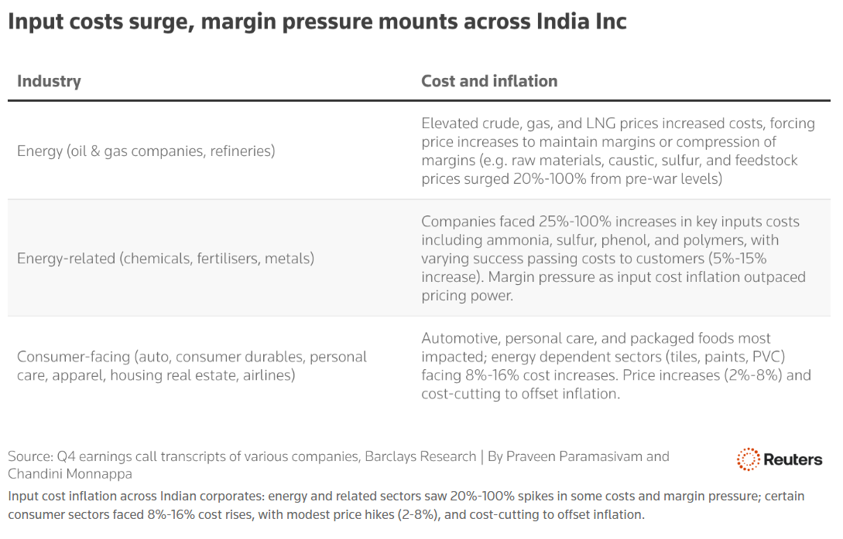
Energy Prices and Input Costs
Source: India Inc hikes prices, shrinks packs as Iran war squeezes margins | Reuters
Notes:
https://openthemagazine.com/business/fuel-fertilizer-and-forex-nirmala-sitharaman-explains-indias-biggest-economic-challenges-amid-west-asia-crisis - challenges ID’ed for economic growth by FM Sitharaman also key challenges for SME sector

Slide 4
Energy Prices and Input Costs
Shipping Costs and Disruptions
Controlled & limited fuel price hike and priority for household consumption, sectoral support (eg: fertiliser subsidies).
But, no enterprise-specific energy price relief.
61.51% inflation in crude 30.33% surge in
fuel & electricity prices in May.
Merchandise Export Forecast:
from $437bn in FY25 to ~ $530bn in FY26
Actual Merchandise Export in FY26: $441.7bn
The Middle East conflict and factors for “Enterprise Insecurity” in India
Currency Depreciation and Inflationary pressures
Loss of investor confidence and capital outflow
The INR fell to an all-time low of 96.82 against the USD in May 2026, but has registered a declining trend since before the war (likely precipitated by US tariffs last year).
The war also caused capital outflow as foreign investors lost confidence in Indian equities, increasing pressure on currency as well as rising crude and other input costs.
RBI measures (eg: cut in capital gains tax) and US-Iran peace talks (lowering energy prices) have improved India’s BoP.
Sources: Press Release Page | Press Information Bureau
  India's exports set to cross $1 trillion in FY26 on robust global demand, says FIEO - The Times of India
  India's wholesale inflation at 9.68% in May under revamped series as Iran war-driven oil costs bite - The Economic Times
  Oil retreat hands RBI an assist in boosting rupee's near-term outlook | Reuters
Notes:
https://openthemagazine.com/business/fuel-fertilizer-and-forex-nirmala-sitharaman-explains-indias-biggest-economic-challenges-amid-west-asia-crisis - challenges ID’ed for economic growth by FM Sitharaman also key challenges for SME sector

Slide 5
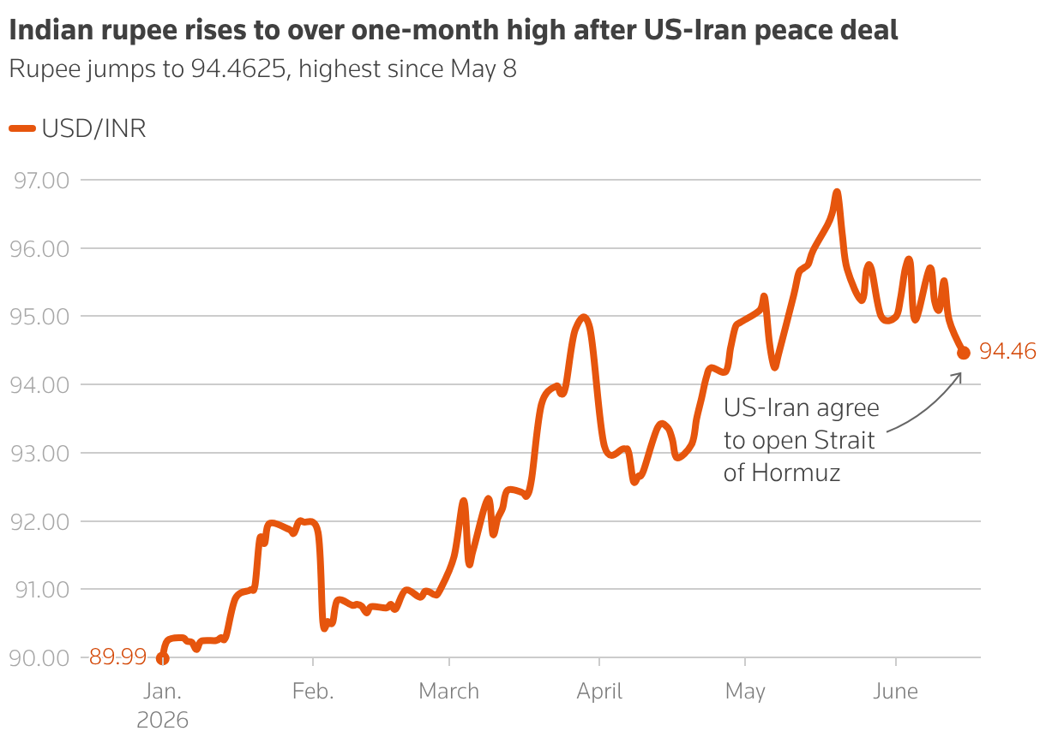
Currency Depreciation and Inflationary pressures
Source: Oil retreat hands RBI an assist in boosting rupee's near-term outlook | Reuters
Notes:
https://openthemagazine.com/business/fuel-fertilizer-and-forex-nirmala-sitharaman-explains-indias-biggest-economic-challenges-amid-west-asia-crisis - challenges ID’ed for economic growth by FM Sitharaman also key challenges for SME sector

Slide 6
Secondary Shocks and SME vulnerabilities
  Insurance premiums and poor access to capital also challenge SME operations, but Government-released schemes have helped firms and SMEs improve credit access and risk coverage since the onset of the war.
  India continues to have positive economic growth (7.8% YoY in Jan-March), with domestic demand offsetting external challenges, but the rate of this growth has slowed.
  However, domestic growth driven by agricultural output, construction sector and investment faces risk of contraction in the coming months, as the war affects fertiliser supply chains, increases steel and building component costs, and weakens the rupee’s competitiveness in the forex market.
  In the long-term, the risk of loss of market access persists as international consumers have begun shifting to alternate markets.
Sources: India's GDP stays robust in January-March as domestic demand offsets external weakness | Reuters
  Why India's SMEs are suffering from Hormuz Strait crisis
  US-Iran War Hits Real Estate: Construction Costs Jump 25%, Delays Loom
  100 days of Iran war, Rs 4,50,000 crore wiped out: Is your stock portfolio safe from missiles? - The Economic Times
Notes:
Buyers in the Gulf and Europe are already exploring alternatives in Vietnam, Turkey, and Bangladesh.

Slide 7
Risks faced by firms
  Operational: lack of/high cost of inputs, export disruptions.
  Liquidity: access to cheap credit, ability to repay after grace periods.
  Solvency: for small firms due to persistent/lasting effects of war on supply chains, poor debt refinancing capacity.
  Long-term sustainability: shifting of consumers to alternate markets, lack of firm adaptability to volatile global market conditions.

Slide 8
OECD work on mitigation of enterprise risks
Policies to strengthen the resilience of global value chains: Empirical evidence from the COVID-19 shock (STI)
Strengthening Economic Resilience Following the COVID‑19 Crisis: A Firm and Industry Perspective (Productivity, Innovation and Entrepreneurship – PIE Division, STI)
Corporate sector vulnerabilities during the Covid‑19 outbreak: Assessment and policy responses
OECD Digital for SMEs (D4SME) Global Initiative
Unleashing SME Potential to Scale Up: Helping SMEs Scale Up (Centre for Entrepreneurship, SMEs, Regions and Cities – CFE)
Scaling Up Public Financial and Non‑Financial Support for SME Sustainability: Innovations and Good Practices (Committee on SMEs and Entrepreneurship – CSMEE)
Policy brief on Making the Most of the Social Economy’s contribution to the circular economy – CFE
Enhancing SMEs’ resilience through digitalisation – CFE
Evolving industrial policy for SMEs as “innovation support, regulatory frameworks, investment in education and skills, quality infrastructure, technology diffusion, as well as targeted government incentives for sustainable long-term growth, strengthening productivity and competitiveness”.
OECD MCM 2026 Chair Statement

Slide 9
ISED and OECD perspectives on enterprise resilience
  The OECD's work on SME and Entrepreneurship Resilience, developed more extensively following the COVID-19 pandemic, highlights the vulnerability of small firms to disruptions affecting demand, supply chains, financing conditions, labour availability, and market access.
  This work emphasises that SME resilience is not solely a firm-level concern but has broader implications for employment, regional development, supply-chain stability, and economic growth, reflecting a perspective similar to ISED's notion of an "insecurity multiplier".
ISED’s Enterprise Security concept | OECD’s entrepreneurial ecosystem resilience
Measures how vulnerable an MSME is to external shocks across financial, operational, market, workforce, and environmental dimensions. This could become an ecosystem-level signal when many firms are vulnerable at the same time. | Assesses whether the ecosystem's institutions, finance, markets, talent, networks, and support services help firms survive, adapt, and grow through shocks
  ISED Enterprise Security concept measures vulnerability at the enterprise level; the OECD diagnostics measure whether the ecosystem amplifies or dampens that vulnerability.

Slide 10
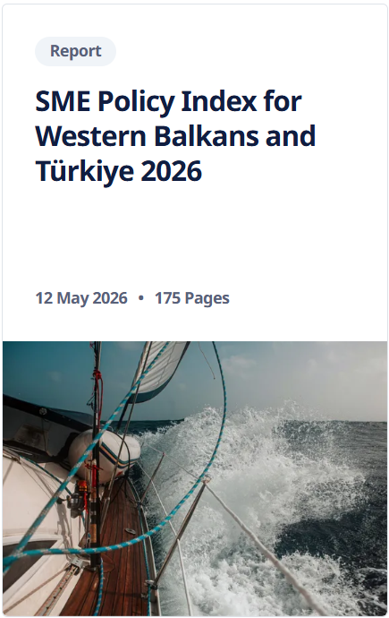
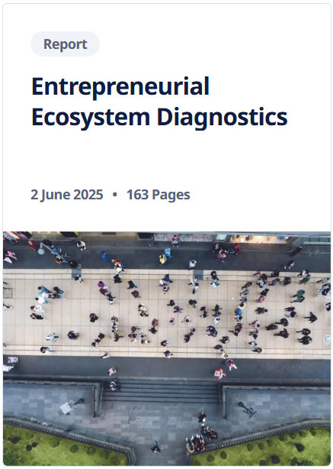
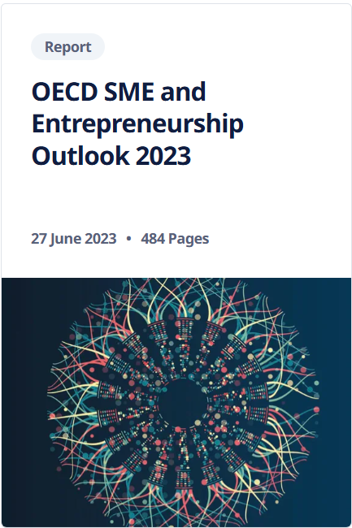
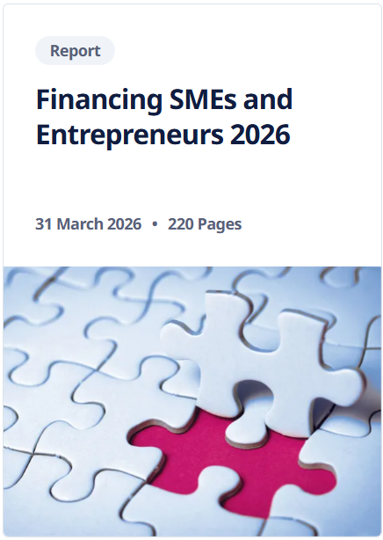
OECD toolkits for building enterprise resilience
Monitoring SME policy environment and
implementation
Dataset + Framework
to track and assess
entrepreneurial performance
SME and Entrepreneurship
trend and performance-tracking (biennial publication)
Scoreboard of Government support, access to finance and financing tools

Slide 11
OECD Entrepreneurial Ecosystem Diagnostics (EED)
  The EED measures the quality of the conditions that enable productive entrepreneurship across 10 ecosystem elements (institutions, finance, markets, talent, networks, etc.), and tracks outcomes such as startup rates, business survival, and high-growth firms.
  Objective: explicit identification of systemic bottlenecks and vulnerabilities in entrepreneurial ecosystems.
Firm-level performance
Entrepreneurial outcomes
Ecosystem conditions
Centrality of EED framework
Interaction between multiple dimensions of the ecosystem, such as Institutions and governance, Finance, Human capital, Markets etc.

Slide 12
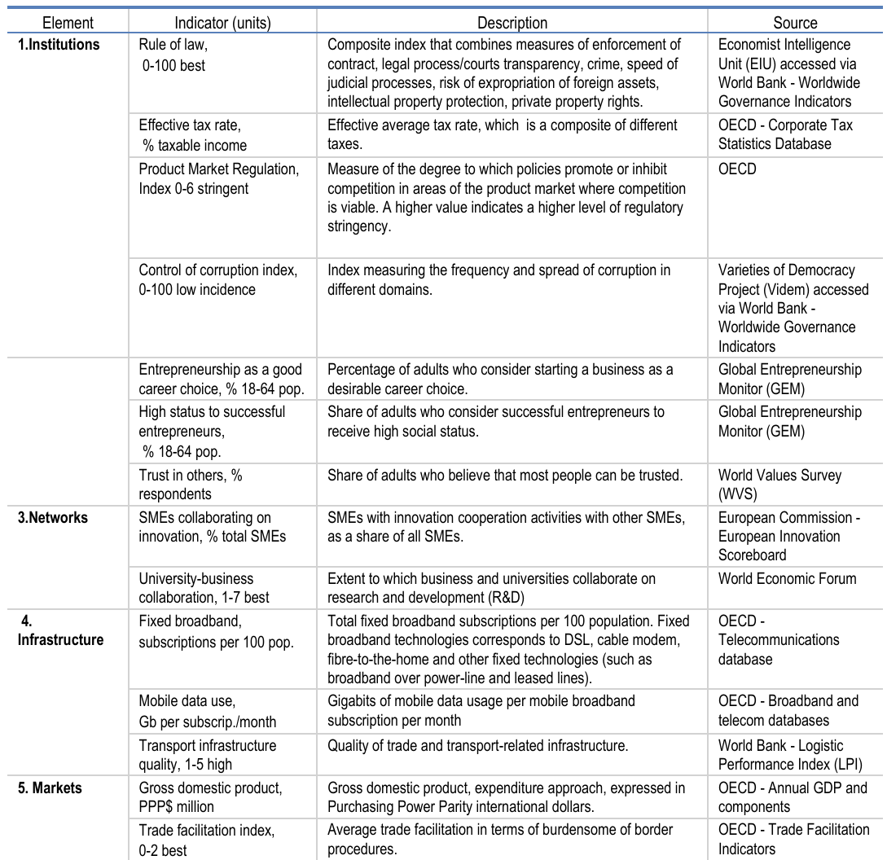
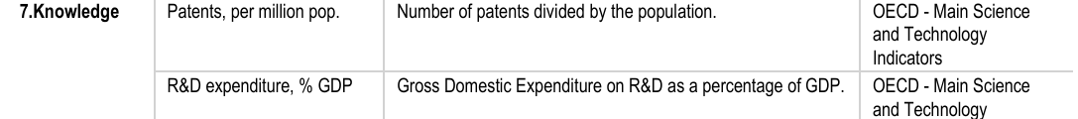
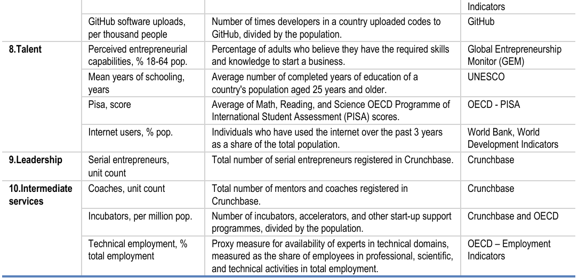
Indicators used to measure Entrepreneurial Ecosystem elements for EED
Source: Entrepreneurial Ecosystem Diagnostics | OECD (2025)

Slide 13
ISED and OECD framework methodologies
  The ISED framework's emphasis on financial, operational, market, social, and environmental vulnerabilities also reflects the OECD's increasing focus on integrated approaches to resilience.
  “Multi-layer diagnostic model”: seeks to identify vulnerabilities across multiple dimensions simultaneously.
    Conceptually close to the EED approach, which recognises that entrepreneurial performance is often constrained by combinations of factors rather than a single market failure.
  “Triple bottom line” perspective:
    Consistent with OECD work linking SME competitiveness with environmental sustainability and inclusive growth.
ISED’s methodology stands as an operational enterprise-level tool for identifying vulnerabilities, prioritising interventions, and supporting evidence-based policy responses, with potential for complementarity to OECD efforts to strengthen SME resilience and economic security.
Notes:
The ISED’s Enterprise Security framework could also be useful tool as an example of a multidimensional framework that helps identify how ecosystem weaknesses and external shocks translate into firm-level vulnerabilities, thereby supporting more targeted SME and entrepreneurship policies. In relation to the OECD work it could resonate and contribute to analysis conducted under the OECD Entrepreneurial Ecosystem Diagnostics, the SME Policy Index as well as OECD work on SME resilience areas of work.

Slide 14
Thank you for your time.
To contact us,
Max Bulakovskiy
Head of the Project Implementation Unit
✉ Max.BULAKOVSKIY@oecd.org
✆ +(33-1) 85 55 64 54

